Slide 1
IOT Project
By,
Akshita Gulati

Slide 2
Purpose
The purpose of this presentation is to put forward an idea that can solve a common problem related to mails which most of us face daily
The solution is developed by keeping “Internet of Things” in mind
Note: This project is basically still in its “First phase” and more changes will be implemented in the future.

Slide 3
Contents
Objectives
The Common Problem
Solution
Fritzing - prototype
Setup and Method
Analysis
Resources
Future implementations
Summary

Slide 4
Objectives
To develop a system that would easily manage mails
To automate the mailing process by sending real time notifications when the mailbox has opened/closed
To contribute to society's move to sustainable development

Slide 5
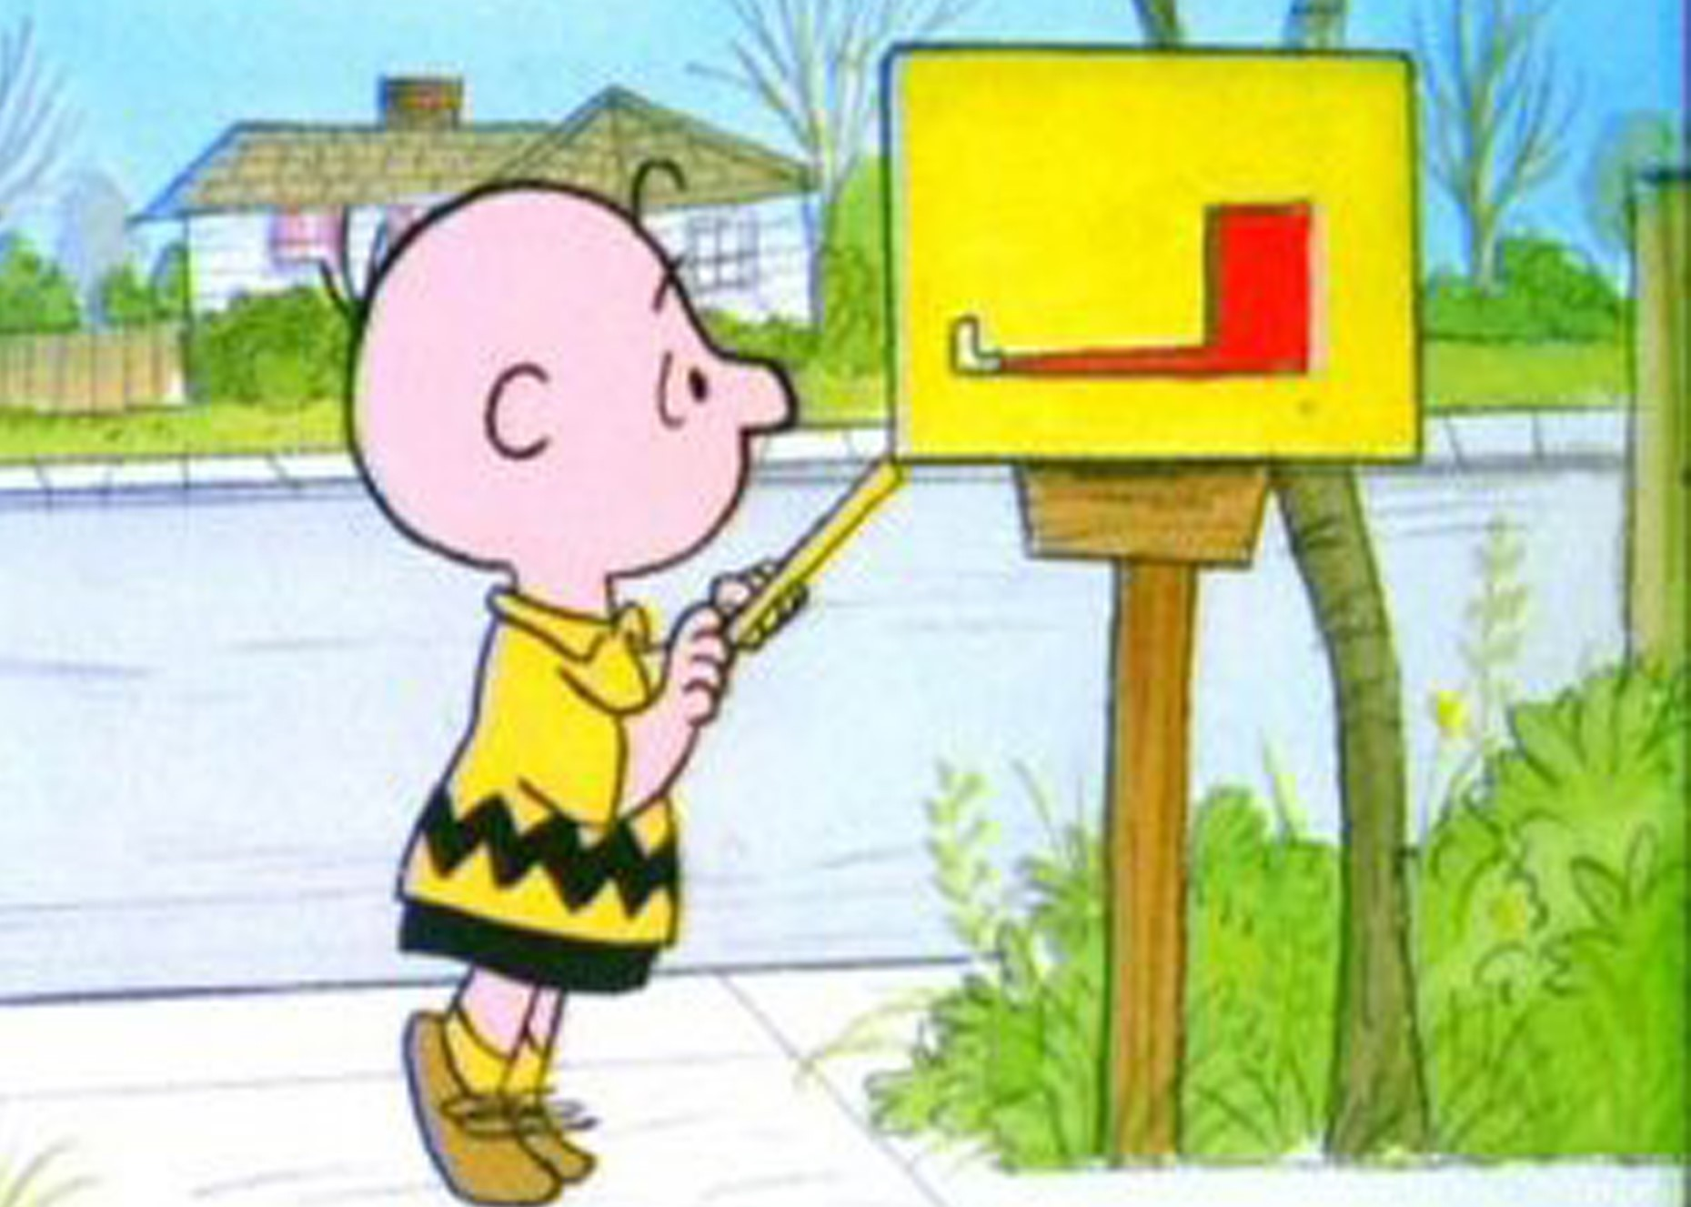
The Common Problem
Sick of walking all the way down your long driveway just to check your mail?
Waiting on a special package and want to know as soon as it arrives?
Never let anyone you care about walk out to an empty mailbox

Slide 6
Solution
My solution to this problem is the “Mailing system”
With the help of this Mailing system an individual would know when his mailbox is opened (or) closed etc with the help of a notification on his phone

Slide 7
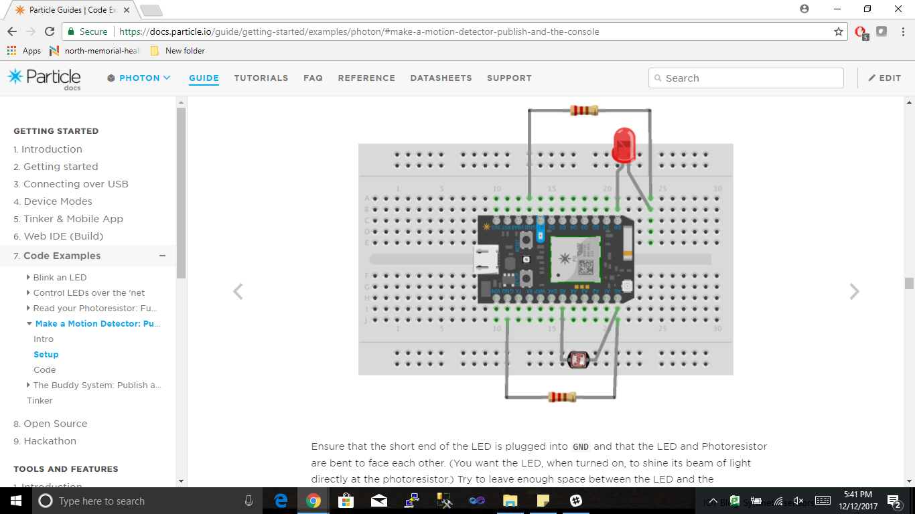
Fritzing - Prototype

Slide 8
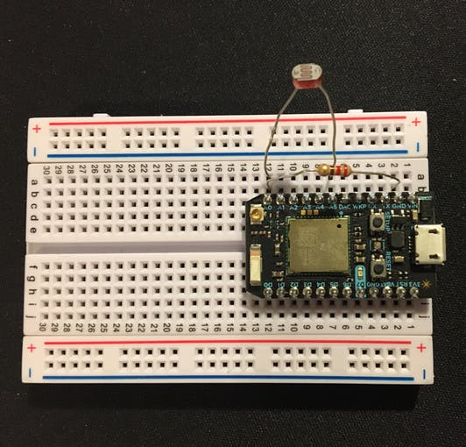
Setup

Slide 9
Method
The first part of this project uses a photoresistor combined with a 220ohm resistor to determine if the mailbox is opened or closed.
A photo resistor will decrease resistance as it is exposed to more light, allowing for a higher voltage reading on the particle, and vice-versa.
IFTTT was utilized to deliver notifications to a mobile phone. The recipe was set up to look for events published from the photon, this is the Particle.Publish line in the code

Slide 10
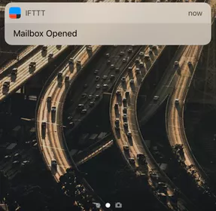
Analysis
On the basis of the trigger generated via the IFTTT notifications are sent on the mobile phone

Slide 11
Resources
Internal Resources(In the kit)
Particle Photon
Photo resistor
Resistor
External Resources(Not in the kit)
IFTT

Slide 12
Future Implementations
Phase-II
To send a notification, to accurately determine if the mailbox is just opened or a mail has actually been placed in it i.e. using the sensitive resistor
Instead of only a notification on the individual's mobile also setup a alarm on its own that buzzes one’s the mail has arrived
Phase-III
Any suggestions from fellow students and professors

Slide 13
Summary
Therefore, by using this Mailing system an individual can easily know when a mail arrives and they don’t have to always stand by the mail box waiting for an important mail.

Slide 14
Questions

Slide 15
Thank you

